Slide 1

Can we ever become Regardless of Race?
By: Group 3
Notes:
Moderator: Welcome to the CNA Insider, Regardless of Race Forum. I am Chi Hui, Chairman of the National body, one.people.sg the national body promoting harmony here in Singapore.

Slide 2
Singapore has enjoyed peace since 1960s...
Most people understand the fundamental ideals the country was built on
Founding leaders stood firm on racial equality
Pioneer and Merderka Generation greatly supported S’pore multiracial policy.
Notes:
Singaporeans have managed to enjoy living in a peaceful and stable multiracial society because most people here understand the fundamental ideals on which the country was built. Singapore’s founding leaders stood firm on the over-arching policy of racial equality in the early years of nationhood. The Pioneer and Merdeka generations, who lived through the country’s turbulent times, also greatly supported Singapore’s multiracial policies. In general, many would describe Singapore as peaceful place, with good racial harmony, good religious harmony.
Despite this, we all know the racism still exists and is endemic and will be here to stay. Racism is something that we always have to contend with but there are groups that are a lot more attuned to racism being an issue especially the minorities group. However, over the past two years, there have been increasing incidences of microaggression, casual racism, exemplified on social.

Slide 3
What does it take to deepen our nation’s racial harmony beyond superficial peace?
Could this perhaps signify that racism has become worse?
Notes:
Could this perhaps signify that racism has become worst? Are we really as harmonious as we seemed to be? At today’s roundtable discussion, we will be confronting the ever divisive and touchy issue of race and religion to see if we can ever become regardless of race. Join us as we seek to address the difficult questions of the day: What will does it really take to deepen our nation’s racial harmony beyond superficial peace? Can we ever become Regardless of Race? Today, I have here with me Kevin representing the Chinese and Malay Community, Louis representing the expat and foreigner perspectives and Reh representing the Indian Community here in Singapore.

Slide 4
Kahoot Time!
Let’s see if you know about racial harmony in Singapore.
Notes:
Before start, let’s see how familiar are you with today’s topic
<insert link>:
Thank you your answers
Moderator: Let’s start with Mr Kevin as a Malay minority Singaporean, what are some of your thoughts of racial harmony in Singapore?

Slide 5
Muslim Perspective
Hijab / Tudung Issue for nurse
Racist comment during Malay Wedding complaining it is too loud
Notes:
Kevin: I feel Singapore is a multi-racial and multi-religious society, and therefore, this is very important for Singapore’s social cohesion. However, I understand this harmony does not come naturally and we need to take the effort to build trust and acceptance between different races and religions. I understand that Singapore government takes a strong stance against discrimination on race, or religions. However, I do think there are some problems or discrimination that I still face.
Kevin: Yeah so , my daughter just finishes her medicine studies last year, and she works at one of the hospitals in Singapore. She mentioned to me that she was shocked when she discovered that she would not be able to wear tudung as a nurse. Initially, the reason was due to infection control purposes, and she was convinced by that reason. Over the years, she realised that doctors, therapist could wear that hijab and they were in close contact with patients too, and she was not very happy with this kind of discrimination. Tudung policy affects nurse differently, the experience of not being able to wear it at work affects each Muslim woman differently, for some people not wearing it makes them lose their identity. My daughter mentioned that due to this policy, many of her friends have left their job.
Kevin: Well, the issue of wearing tudung's with public service uniforms have always been debatable. This issue was also debated parliament where Minister-in-charge of Muslim Affairs Min Masagos mentioned that public service's policy on uniforms cannot be tilted towards any particular religious beliefs. To quote: Allowing tudungs will raise a very visible religious marker that identifies every tudung-wearing female nurse or uniform officer as a" Muslim. This has significant implications," he added.
Kevin: Another example: when my son has his wedding, a lot of our neighbours complained and made a racist comment about the wedding. They mentioned it is very loud and noisy. As an ethnic minority living in Singapore, this is not something new, and seeing others have a superficial understanding of our culture is very unpleasant. I do understand that sometimes it may create a bit of noisy annoyance during the wedding, but I never expect that our society make a racial comment about it, considering that we are living in multicultural society.

Slide 6
Singapore Government Response
Reversing tudung policy
More sensitive
Nurses will be allowed to wear tudung
From November 2021
Take into consideration whether certain policy will affect certain group
Notes:
Moderator: I understand you must be very frustrated having faced this kind of differential treatment.
For the Tudong issue I’m sure that this policy has strong implications on the Muslim community. I believe our government has taken a very proactive approach to considering this issue where they have decided to take the approach of “careful closed-door discussions”, as they understand the “complexity and sensitivity” of the issue. This is the definitely the approach for all racial policies and issues now.
Im sure you would be happy to hear that in Aug this year nurses in the public healthcare sector will be allowed to wear a tudung with their uniforms if they want to from November.

Slide 7
Solutions
01
Change our mindset
02
From tolerance to acceptance
Building bridges
Organize activities that connect different cultural groups
03
Law Enforcement
More strict law enforcement on discrimination cases
Notes:
Kevin: Well, I agree with you, I am very happy to hear that. In addition, I think our government is also working very hard on this issue, and I notice apart from the tudung policy is being reversed, the government is also working hard especially when they introduce new policy, as they are more sensitive toward different groups. To add upon that, from my perspective I think there are lots of things that can be done to achieve this. First, I think it is important to change our mindset from tolerance to acceptance. Instead of being ignorant to other culture, I think we should support different culture and be positive about it. Secondly, I think it would be good if our society organize more building bridges activities that can connect different groups together.
Moderator: Thank you Mr Kevin for comments and opinions.

Slide 8
Foreigners’ Perspective
CECA policy
Competition with foreigners
Population growth
Give Indian free entry to work in Singapore
Workplace, home in HDB estates, school placements
Congestion, overcrowding of public services, ...
Notes:
Foreigners Perspective
Moderator: Next, we will move on to Mr Louis, who will share his experience as a foreigner living in Singapore. The issue strong anti-foreign sentiment and xenophobia having been strongly felt throughout the nation especially w.r.t CECA policy. What do you feel as a foreigner?
Louis: From my perspective, as a foreigner coming to study and work in Singapore, I feel that there exists an anti-foreigner sentiment in Singapore’s society. There needs to be an acknowledgement that many Singaporeans are feeling stresses of having to compete with foreigners - and new citizens, it happens in the workplace, as well as for homes in HDB estates and school placements.
One of the most debatable topics about foreigner that I have heard of is the Singapore-India Comprehensive Economic Cooperation Agreement (Ceca). This policy is being criticised by some citizens as they believe that it is letting professionals, managers and executives from India to Singapore unconditionally.
However, I do acknowledge that population growth from immigration also tends to come with some short-term problems, such as congestion, overcrowding of public services and social upheaval as natives adjust to new cultural ideas.

Slide 9
Key Facts
112,000
380,000
2005-2020
EP holders
Local PMEs
Notes:
Louis:
However, according to gov’s statistics, the number of Employment Pass (EP) holders in Singapore increased from 65,000 in 2005 to 177,000 in 2020. This translates to an annual growth rate of just under 7 per cent, and an increase of 112,000. In comparison, the number of local PMEs grew by more than 380,000 in the same period. I think Singaporeans should not be overly worried about having too many foreigners as the government is definitely tightly regulating who can enter the country.

Slide 10
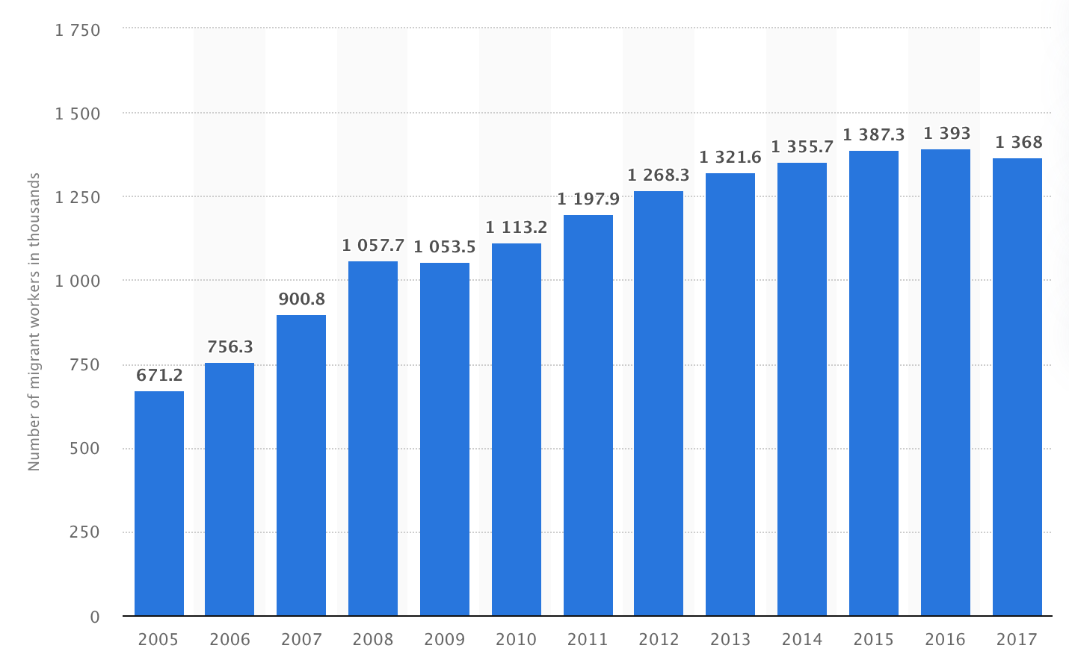
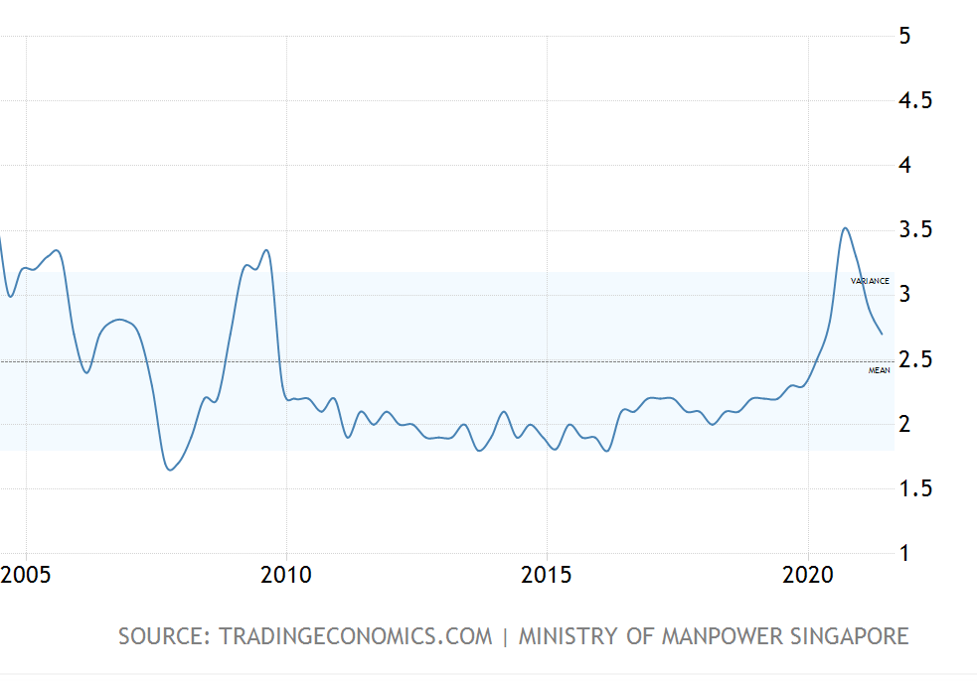
Job Market Statistics
Foreign Workers
Unemployment Rate
Increase by 100%
Almost Stable
Notes:
Also, Long-trend data from the Singapore Department of Statistics and Ministry of Manpower shows that Singapore’s foreign workforce population has tripled in the span of three decades, while resident unemployment rates have remained stable. This means the job market is expanding drastically and foreigners are not taking away opportunities of local residents.

Slide 11
Aggression Against Foreigners
Rising costs of living
Lack of acceptance
More competition for jobs
Notes:
Reh: I am sry to hear that. Well, unintentionally we might have made racist remarks especially when we see jobs getting taken away along with rising costs of living!
The issue of foreigners competing for jobs with Singaporeans is something that is widely talked about especially in the past few years given the ever-changing and globalising international labour market.
Many Singaporeans believe that they are being passed over for jobs that they can do because foreigners come cheaper, without the employer having to pay for Central Provident Fund contributions and deal with National Service obligations, or simply because employers prefer to bring their own friends and families from overseas to fill vacancies
Although Expats, foreign talent and immigration make Singapore economically better off, it is indeed true that the cost of living does increase drastically especially with regards to transportation cost, food prices and housing costs.
Law and Home Affairs Minister Mr K. Shanmugam recently mentioned that Groups have been capitalising on Singaporeans' anxiety over jobs to fan the flames of xenophobia and racism, and that such racist behaviour will become normalised if Singapore is not careful
Due to the lack of acceptance, it is indeed a fact that we are in a time where we have to accept the existence of aggression against foreigners. However, singapore does need foreigners.

Slide 12
Regardless, we still need foreigners...
Low birth rate
Social Diversity
Ageing population
Economic growth
Both labor-intensive and capital-intensive workforce
Notes:
Reh:
Given the limited size and rising age of Singapore's workforce, Low birth rate and ageing population, foreign manpower is needed to augment our Singapore core and to meet the needs of our economy and businesses. Having access to sufficient manpower and global talent is crucial to support the growth of our economy and for businesses to be able to create and secure good jobs for Singaporeans. With the influx of migrants to come and work in Singapore, we are opening opportunities for new investments and exposing our local employees with talents around the world who can transfer new skillsets to our local citizens. As Singapore continues to follow the approach of open economy, the posting of foreign employees in and out of Singapore is an essential part of the smooth operations of multinational companies using Singapore as their regional or global hub.
Besides adding value to the economy, foreigners create value in other ways too - for example, they add social diversity by bringing in their own local cultures and rituals to Singapore, which enriches our society and makes our island one with rich values and makes itself represent as a land of opportunities for people from all around the world.

Slide 13
“The combination of the lack of legislation against xenophobia, and the justification of xenophobia as the mere expression of economic anxieties rather than an emotional response or outright discrimination, has normalised anti-foreign sentiments”
Notes:
Reh:
Ms Yasmine Wong, senior analyst at the Centre of Excellence for National Security in NTU's S Rajaratnam School of International Studies, mentioned that, “The combination of the lack of legislation against xenophobia, and the justification of xenophobia as the mere expression of economic anxieties rather than an emotional response or outright discrimination, has normalised anti-foreign sentiments” and this is indeed proof to say that competition in jobs and general economic growth does cause aggression against foreigners indirectly.
Moderator:
Well, thank you Reh and Louis for your inputs that’s sad to hear such aggression and anti-foreign sentiment exists. Hmm, this will beg the next question of do you having any inputs on what are steps are you think can help reduce this anti-foreigner sentiment and racism that might inevitably due to economic anxieties.

Slide 14
Solutions
01
Local residents
02
Understand their benefits from foreigners
Enterprises
Upskill local employees to in trend with global standard
03
Government
Keep the right balance between foreigners and native people.
Notes:
Louis:
Me I would like to share! I think to reduce these anti-foreign sentiments, Singaporeans must all come to understand that we will always need foreigners around like what Reh mentioned. I do agree that in the future foreigners will still occupy a certain workforce percentage in Singapore.
And to mitigate the anti-sentiment issues, there are some actions that should be taken. Firms must keep reskilling and upskilling local employees, and facilitate the transfer of "niche and business-critical skills" to local employees, to build a sustainable pipeline of local talent. In this way, local citizens skills are always in trend with the global standard. Also, by combining and complementing local and foreign expertise, we can attract more investments and create many more good job and career choices for Singaporeans.
There is a trade-off at play here: many jobs, strong competition; or few jobs, no competition. We need to find the right balance where there are more jobs, some competition.
Regarding the gov, they can take actions to incentivise childbirth for young parents, as is already being done with a range of housing grants and parental/education subsidies.
Moderator: Thank you both for commenting on jobs as well as sharing how these policies affect how we as Singaporeans and foreigners living here in Singapore feel. I think we all know that jobs are always a sensitive topic for Singaporeans. Fundamentally, Singaporeans will need to come understand that as we live in a global and open economy and there will always be foreigners competing for jobs with us. Instead of feeling angry and anxious, we should continue to strive to make ourselves more competitive and improve ourselves.

Slide 15
Chinese Privilege
Majority
Should not be used as blanket term
Advantages
More than 75% of Singapore population
Easier to find jobs in tuition industry
Discrimination to other groups
It will closes off conversation
Notes:
Chinese Perspective
Moderator: Next, we will get the Chinese perspective, from Mr Kevin. As a majority race in Singapore, what do you think about racial issues. Recently, there has always been this term “Chinese privilege” being brought up and even PM Lee talked about it during his NDR. Can you give us a brief overview of what’s that and personally what do u feel about this term being used.
Kevin:
Basically, Chinese Privilege argues that Chinese Singaporeans which constitutes around 75% of the population size since colonial times, unlike minority Malays, Indians, or Eurasians, enjoy exclusive racial advantages. Well, I have to accept the fact that there is some kind of privilege if you’re part of the majority and sadly there will definitely be somethings that makes it a little easier for us. As the majority, we might live in our own small little bubble if we do not have enough contact and conversations with people from different races. This might result in Chinese making racist comments/actions intentionally or unintentionally.
For example, in the tuition industry, Prospective tutors being rejected by parents of students on the sole basis of their race. I heard a case where Singaporean woman messaged a user for a particular job, but rejected with 1 line reply of “Chinese tutor preferred sorry” (Mothership SG article). There is also a case where a parent requested child not to be taught by qualified Indian tuition teacher. So, what happen is the student’s parent complained to the head of tuition centre that she did not want her child being taught by an Indian.
At the same time, we have to be careful of how we label that to the term Chinese Privilege.
We shouldn’t use Chinese privilege as a blanket term, as that is definitely going to closes off conversations. It kind of put it as one particular race, the Chinese are the source of all problems and that should not be the case.
Moderator: Well, I totally agree with your POV. As the majority race myself, we definitely need to take a little more effort and be more aware of own biases. I think firstly it’s our responsibility to educate ourselves and be open-minded. Regardless, we should not use labelling such a Chinese privilege casually as what Mr Kevin shared as this closes off conversations

Slide 16
Ethnic Integration Policy (EIP)
The EIP is put in place to preserve Singapore's multi-cultural identity and promote racial integration and harmony.
Notes:
Indian Perspective (Rehman)
Moderator: Moving on lastly speaker, Reh who will share about the Indian perspective, as a minority race in Singapore, in terms of housing, what are some challenges u have faced
Over last few decades, our government has already worked on housing policies like the Ethnic Integration Policy (EIP) to preserve Singapore's multi-cultural identity and promote racial integration and harmony. It ensures that there is a balanced mix of the various ethnic communities in HDB towns. The EIP limits are set at block/ neighbourhood levels based on the ethnic makeup of Singapore. However it has both pros and cons. Under the EIP, there are limits on the total percentage of a block or neighbourhood that may be occupied by a certain ethnicity. Without EIP, there might be ethinic concentration due to personal preferences. Individuals would want to live near family members or that residents of certain ethnic groups may prefer neighbourhoods with a higher concentration of specific amenities and services or larger flat types.
If we don’t live with one another, it makes it much harder to empathise with other communities and understand the challenges they face, and much easier to stereotype or assume the worst of those who are different from us. This is a recipe for mutual mistrust and intolerance.
On the other side, this policy still has some limitations. Firstly, sellers of other ethnicities unable to sell to buyers of a certain ethnic group once the EIP is reached for that group. A 2017 study by the Association of Muslim Professionals found that apartments reserved for Chinese residents in cheaper estates sat vacant, presumably because wealthier Chinese didn’t want to live there. Likewise, apartments for Muslims in higher-priced areas like Bedok were difficult to fill.
Also, many people believe that living next door to someone from a different race or religion does not mean people will learn to tolerate or understand differences. Recently, there was a video recorded about Singapore neighbour clangs gong repeatedly as man performs Hindu prayer. This is a typical example that justifies the fact that not everyone can accept and respect the differences in cultures which is the driving factor of discrimination.

Slide 17
“No Indian” “No Malay” “No PRC”
49
60%
Insensitive housing listings as of late Feb 2017
Of landlords prioritise racial profile of prospective tenants over profits and costs
Notes:
Reh: In public housing for example, quotas are enforced to prevent any ethnic group from being over-represented. But no such legislation applies to private properties. In fact, some owners of private residential properties routinely exclude individuals from tenancy based on ethnicity, even explicitly stating in advertisements that requirements are “no Indians/ PRC” (slang for People’s Republic of China) or “no Malay.”
As of late February 2017, at least 49 listings across popular housing portals PropertyGuru, Craigslist, and Gumtree clearly stated that at least one of those three ethnicities were not eligible tenants. These ads are typically placed by real estate agents, who often find themselves in the position of sieving out tenants on behalf of unit owners’ ethnic preferences.
Technically, landlords can’t really be choosy in this market, but only 40 percent are conscious of profits and costs. The other 60 percent are highly sensitive to the profiles of prospective tenants and thus susceptible to racial bias

Slide 18
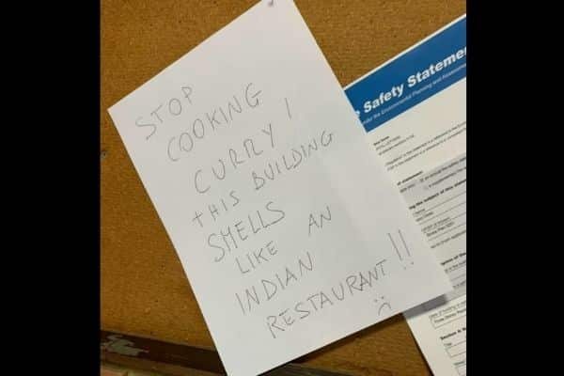

Friction
Police investigating woman filmed on video disrupting neighbour's Hindu prayers
“Stop cooking curry”: when neighbours complain about ‘smelly’ Indian food
Notes:
Police investigating woman filmed on video disrupting neighbour's Hindu prayers
“Stop cooking curry”: when neighbours complain about ‘smelly’ Indian food

Slide 19
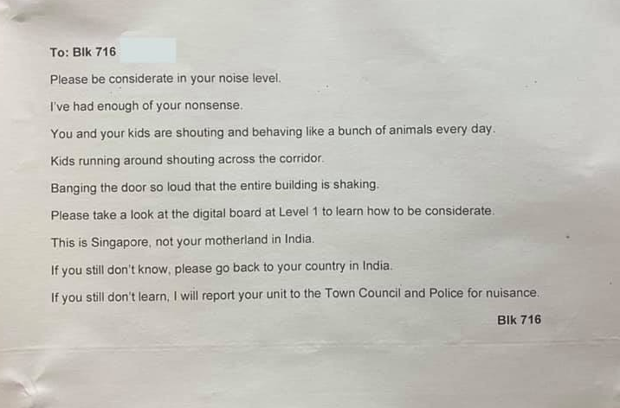
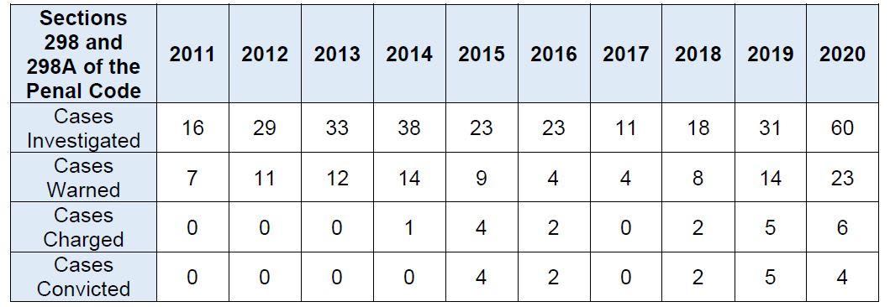
Friction
West Coast resident leaves note in the lift: “This is Singapore, not your motherland in India”
Police reports on incidents with racial or religious friction doubled in 2020: Shanmugam
Notes:
West Coast resident leaves note in the lift: “This is Singapore, not your motherland in India”
These are just some of the headlines from the local newspaper Straits Times from the past 3 months.
It is indeed evident that there is both micro and extreme aggression and racism shown against certain racial groups when it comes to housing.
In fact, Law and Home Affairs Minister Mr K. Shanmugam mentioned that Police reports on incidents with racial or religious friction doubled in 2020

Slide 20

Acceptance
Harder being in a minority group than in a majority group
Discrimination in housing by landlords
Discrimination in schools and workplaces
Notes:
we must recognise that in any multi-racial society, it is harder to be a minority than a majority. This is so everywhere in the world
It is important for the majority community in Singapore to do its part, and be sensitive to and conscious of the needs of minorities
Singapore has come in racial harmony since independence, and Singapore's dynamic and delicate multi-racialism.
it matters to someone who faces discrimination when looking for a job, or feels left out when everyone else in a group speaks in a language that not all can understand. We are in 2021 however there are still landlords in Singapore who specify a preference for some races.
It matters to our students, neighbours, co-workers and friends who have to deal with stereotypes about their race, or insensitive comments.
These things do happen, not always, and perhaps not even often, but sometimes they do. And when they do happen, they cause real hurt, which should not erased by lightly dismissing them as casual remarks or jokes

Slide 21
Conclusion
02
01
Government
Singaporeans
Continuously engage the ground and the community on a wide variety of issues
Rigorously debate & update policies formulated
F0CUS on REAL issues. Not symbols.
Important for majority to acknowledge some forms of advantage exists
To be sensitive to the needs of the minorities
Seek to continue with our approach of mutual accommodation, trust and compromise regardless of race.
Notes:
Reh: Yes, I do agree! We have to acknowledge that there is a problem in the first place before addressing the issue. There are problems existing currently with regards to micro-aggression and racism against minority groups.
Conclusion
Moderator:
After listening many of the examples of racists incidents, microaggression faced by the minority community as well as hearing from the majority perspective. Let us circle back to the main question that were posted at the start of the forum and summarise our learnings from the different speakers. Well, What will it really take to deepen our nation’s racial harmony beyond superficial peace?
I believe we can come to agree on this from two main stakeholders involved.
First, the government needs to continuously engage widely on racial issues and rigorously debate on policies that formulated. They need to focus on focus on real issues. Not symbols that are not important.
For Singaporeans, especially for the majority, it is important for majority to be sensitive to the needs to the minority. We must recognise that in any multi-racial society, it is harder to be a minority than a majority. This is so everywhere in the world. So, it is important for the majority community in Singapore to do its part and be sensitive to and conscious of the needs of minorities. This cuts across all aspects of daily life.
We shall always seek to continue with our approach of mutual accommodation, trust, and compromise regardless of race.
We must also not that with the advent of social media, it has amplified a lot of racial faults and tension that were previously not as obvious. The many incidents highlighted by our speakers only came to light because of social media. In Singapore case, this might be a positive thing as it has fuelled a lot of conversations and debates about this issue, and I believe open conversations sway to go going forward.

Slide 22
Racism will always be endemic, we should all deny acceptability to acts of hate. We shall strive for is no place for racism in Singapore. No ifs. No buts.
Notes:
We must always bear in mind that though, racism will always be endemic, we should all deny acceptability to acts of hate. We shall strive for is no place for racism in Singapore. No ifs. No buts

Slide 23
Kahoot Time!
Let’s see what you have learnt!.
Notes:
Let us do quick kahoot quiz to see if u have a better understanding of the racial incidents and racial harmony in singapore

Slide 24
Thank
You!
Do you have any questions?

